Slide 1
Issue of web

Slide 2
Members
Pujan thapa magar
Prabin subedi
Rabin sharma

Slide 3
CONTENTS
TIER TECHNOLOGY
ISSUE OF WEB
ONE TIER TECHNOLOGY
TWO TIER TECHNOLOGY
THREE TIER TECHNOLOGY

Slide 4

INTRODUCTION
"Tier Technology" is not a well-known or widely recognized concept in the technology field. It's possible that the term has emerged or gained significance after my last update, or it might refer to a specific concept, product, or framework that has been introduced since then.
If you could provide more context or details about what you mean by "Tier Technology," I would be happy to try to help you better understand or provide information about it based on the information available up to September 2021. If this is a recent development or a specialized term, I recommend checking more recent sources or providing additional context for a more accurate response.
Notes:
Shorting in Java refers to the process of sorting elements in a collection or array in a specific order, such as in ascending or descending order. It allows you to rearrange the elements based on a certain criterion, making it easier to search, analyze, or present the data.
In Java, the most common approach to sorting is using the java.util.Arrays or java.util.Collections classes, which provide various methods for sorting arrays or collections.
To sort an array of primitive types, such as integers or doubles, you can use the Arrays.sort() method. Here's a simple example:

Slide 5
Presentation Layer
It is also known as the Client layer. The top most layer of an application. This is the layer we see when we use the software. By using this layer we can access the web pages. The main function of this layer is to communicate with the Application layer. This layer passes the information which is given by the user in terms of keyboard actions, mouse clicks to the Application Layer.
For example, the login page of Gmail where an end-user could see text boxes and buttons to enter user id, password, and to click on sign-in.
Notes:
Built-in Sorting Methods:

Slide 6
Application Layer
It is also known as Business Logic Layer which is also known as the logical layer. As per the Gmail login page example, once the user clicks on the login button, the Application layer interacts with the Database layer and sends required information to the Presentation layer. It controls an application’s functionality by performing detailed processing. This layer acts as a mediator between the Presentation and the Database layer. Complete business logic will be written in this layer.
In simple words, it is to perform operations on the application.
Notes:
Built-in Sorting Methods:

Slide 7
Data Layer
The data is stored in this layer. The application layer communicates with the Database layer to retrieve the data. It contains methods that connect the database and performs required action e.g.: insert, update, delete, etc.
In simple words, it is to share and retrieve the data.
Notes:
Built-in Sorting Methods:

Slide 8
01
ONE TIER TECHNOLOGY

Slide 9
ONE TIER TECHNOLOGY
One-tier architecture has all the layers such as Presentation, Business, Data Access layers in a single software package. Applications that handle all the three tiers such as MP3 player, MS Office come under the one-tier application. The data is stored in the local system or a shared drive.
Notes:
Built-in Sorting Methods:

Slide 10
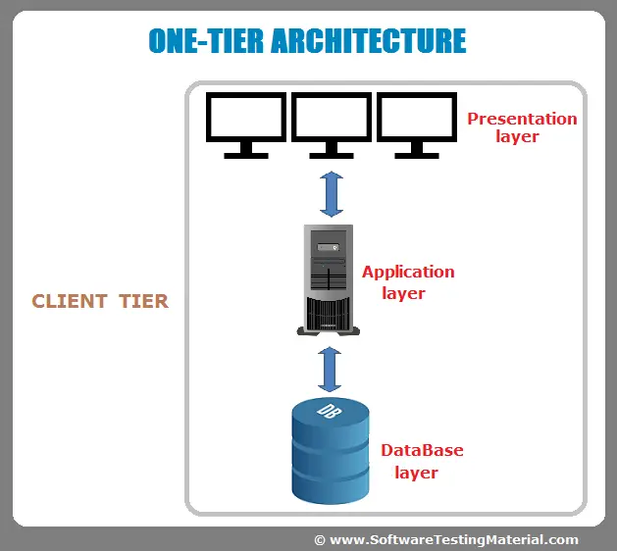
FOR EXAMPLE

Slide 11
2- TIER TECHNOLOGY
A two-tier architecture is a software architecture in which a presentation layer or interface runs on a client, and a data layer or data structure gets stored on a server. Separating these two components into different locations represents a two-tier architecture, as opposed to a single-tier architecture. Other kinds of multi-tier architectures add additional layers in distributed software design.

